Slide 1
READ ME [1 of 2]
Delete this slide.
Presenting
  The purpose of the project plan presentation is to convince everyone that your team has scoped your project, understands the functional, design and technical specifications, and that your team has a crafted plan to develop, debug and deliver your project to your client on time (Wednesday, April 24) and on budget ($0).
  The time limit for your presentation is 14 minutes, which will be strictly enforced. Practice your presentation to ensure that you will finish within the allotted time.
  All team members are required to dress business casual on the day of their presentation. Business casual does not include sneakers, tennis shoes, hats, coats, hoodies, t-shirts or shirts that are not tucked into pants. Google “what is business casual.”
  “Formal” team photos of the presenting teams will be taken in the Capstone Lab immediately following these all-hands meetings. Plan on it.

Slide 2
READ ME [2 of 2]
Delete this slide.
Content
  Do not include any company confidential information in your presentation since all presentations will be posted on the web site.
  Submit your presentation to your client for approval at least two days in advance.
  Throughout the PowerPoint template, replace placeholders […] with the appropriate information.
  Edit the center footer by clicking the Header & Footer button on the Insert ribbon. Change [Team Name] in the footer to your company name as in “Team TechSmith Project Plan Presentation”. If necessary, extend the width of the center footer textbox on the master slide, making sure that you re-center the enlarged textbox.
  Delete the example Screen Mockups and System Architecture slides and all Read Me slides from your presentation.
    The screen mockups should contain little or no bordering transparent or whitespace. Use paint.net to crop them appropriately.
    If a slide contains more than one screen shot or additional artwork (like an arrow), group all of the items into a single grouping so that it can be copied-and-pasted and resized as a single unit
Required Template
  Do not edit the Slide Masters.
  Do not change the organization of slides.
Presentations
  Although the presentations are scheduled over the course of four meetings, all teams must be prepared to present on the first day scheduled, Tuesday, January 29.
  The order of the presentations will be posted on our All-Hands Meetings page in the evening of the day before the first day scheduled for presentations.
Submission ← Read this carefully.
  Both your PowerPoint slide deck and Word document are due by 12:01 a.m. on Tuesday, January 29. Email your slide deck to Dr. D. and your document to your TA. Email both your slide deck and document to your client in a separate email; do not cc me.
  For subject, use “Team [Team Name]: Project Plan Presentation” as in “Team Amazon: Project Plan Presentation”.
  Attach the Windows PowerPoint source file named “team-[team-name]-project plan-presentation.pptx” replacing “[team-name]” with your team name (using all lower case and replacing all blanks with dashes) in your filename as in “team-urban-science-project plan-presentation.pptx”.
  Attach the Windows Word source file named “team-[team-name]-project plan-document.docx” replacing “[team-name]” with your team name (using all lower case and replacing all blanks with dashes) in your filename as in “team-urban-science-project plan-document.docx”.
  Include some text in the body to practice being a professional and to avoid having your email sent to my junk folder.

Slide 3
Project Plan
[Project Title 36pt]
Team [Team Name 24pt]
[Team Member 1 16pt]
[Team Member 2 16pt]
[Team Member 3 16pt]
[Team Member 4 16pt]
[Team Member 5 16pt]
[Team Member 6 16pt]
Department of Computer Science and Engineering
Michigan State University
Spring 2019

Slide 4
Functional Specifications
Point 1
Point 2
Point 3
Etc…
This is your project overview.
Describe what problem your project solves.
Answer the question “What does your project do?”
This is your “elevator pitch”.
Delete this textbox.

Slide 5
Design Specifications
Point 1
Point 2
Point 3
Etc…
Articulate a summary of your project’s major features as well as its overall design.
Delete this textbox.

Slide 6
Screen Mockup: [Title 1]
You may include as many screen mockups as you have like, but you must include at least four examples.
To include more than four, you can duplicate this slide as many times as necessary.
Good screen mockups should help you elicit project specifications from your client.
Do not include screen mockups of trivial things such as splash screens or login screens.
Do not include screen grabs of other software.
Give each screen mockup slide a title.
See below for examples and instructions.
Delete this textbox.

Slide 7
Screen Mockup: [Title 2]
You may include as many screen mockups as you have like, but you must include at least four examples.
To include more than four, you can duplicate this slide as many times as necessary.
Good screen mockups should help you elicit project specifications from your client.
Do not include screen mockups of trivial things such as splash screens or login screens.
Do not include screen grabs of other software.
Give each screen mockup slide a title.
See below for examples and instructions.
Delete this textbox.

Slide 8
Screen Mockup: [Title 3]
You may include as many screen mockups as you have like, but you must include at least four examples.
To include more than four, you can duplicate this slide as many times as necessary.
Good screen mockups should help you elicit project specifications from your client.
Do not include screen mockups of trivial things such as splash screens or login screens.
Do not include screen grabs of other software.
Give each screen mockup slide a title.
See below for examples and instructions.
Delete this textbox.

Slide 9
Screen Mockup: [Title 4]
You may include as many screen mockups as you have like, but you must include at least four examples.
To include more than four, you can duplicate this slide as many times as necessary.
Good screen mockups should help you elicit project specifications from your client.
Do not include screen mockups of trivial things such as splash screens or login screens.
Do not include screen grabs of other software.
Give each screen mockup slide a title.
See below for examples and instructions.
Delete this textbox.

Slide 10
Screen Mockup Instructions
Notes on Making Your Mockups
Delete this slide.
Ensure that your mockups…
  are readable (size-wise),
  have the correct aspect ratio,
  are scalable, and
  are centered vertically (between the green bar in the title and the footer) and horizontally (Use Home > Arrange > Align).
The screen mockups should not contain any bordering transparent or whitespace. Use paint.net to crop them appropriately and change any bordering whitespace to transparent.
In PowerPoint use Home > Arrange > Group to group the objects in your mockup into a single object that can be copied-and-pasted (and scaled).

Slide 11
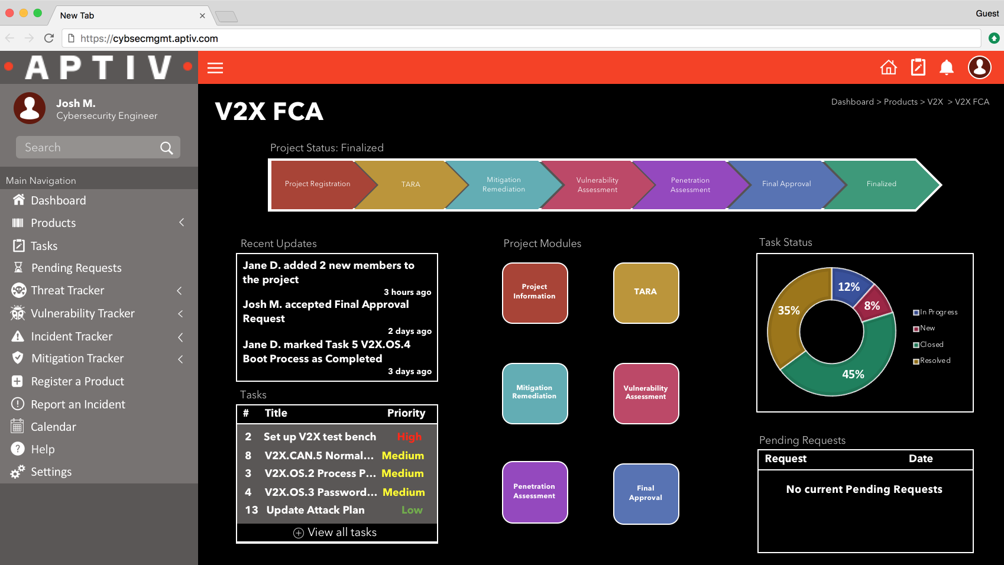
Screen Mockups: Phone Interface
Example of Good Screen Mockup
Delete this slide.

Slide 12


Screen Mockup: iOS Application
Example of Good Screen Mockup
Delete this slide.

Slide 13
Technical Specifications
Point 1
Point 2
Point 3
Etc…
List the technical components of your project.
Delete this textbox.

Slide 14
System Architecture
Show a diagram that illustrates the overall architecture of your project including how all of the parts and pieces are connected and interact.
See below for examples and instructions.
Delete this textbox.

Slide 15
System Architecture
Notes on Making Your Diagram
Delete this slide.
Draw your system architecture diagram natively in PowerPoint; do not cut-and-paste a diagram from your project plan document.
Create your system architecture diagram in a separate PowerPoint file.
  Use a white background with a blank slide layout.
  Use Home > Arrange > Group to group all of the objects in your diagram into one single PowerPoint object that can be copied-and-pasted.
  Once grouped, save the diagram as a PNG image so that the entire image will scale including text.
Use Paint.NET to make the background of your diagram transparent.
  Download and install it from www.getpaint.net.
  Copy your diagram into Paint.NET.
  Select Tool > Magic Wand.
  Click on a background area.
  Push the Delete button (on your keyboard).
  The background area should be a checkerboard pattern.
  (N.B.: Paint.NET was a capstone project at the University of Washington.)
Copy-and-paste your PNG image into the slide deck System Architecture slide.
Ensure that your diagram…
  is readable (size-wise) when projected,
  has the correct aspect ratio,
  is scalable, and
  is centered vertically (between the green bar in the title and the footer) and horizontally (Use Home > Arrange > Align).
Read this carefully.

Slide 16
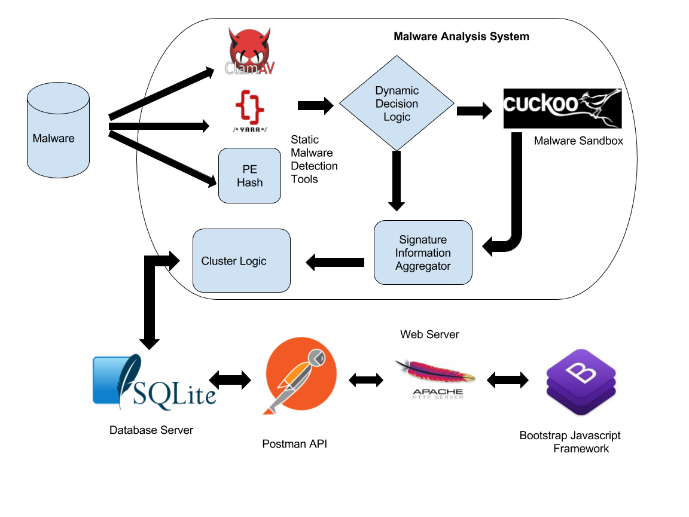
System Architecture
Example of Good System Architecture Diagram
Delete this slide.

Slide 17
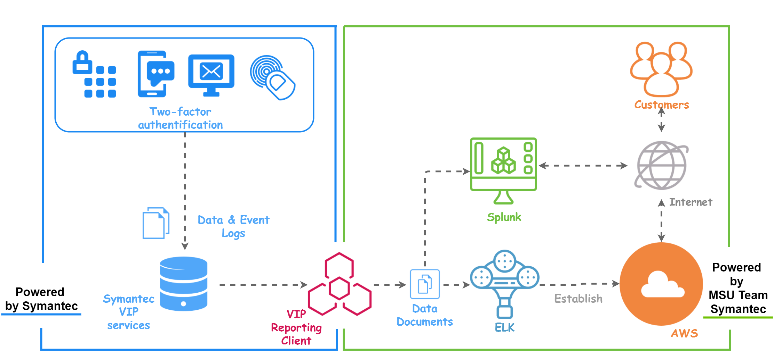
System Architecture
Example of Good System Architecture Diagram
Delete this slide.

Slide 18
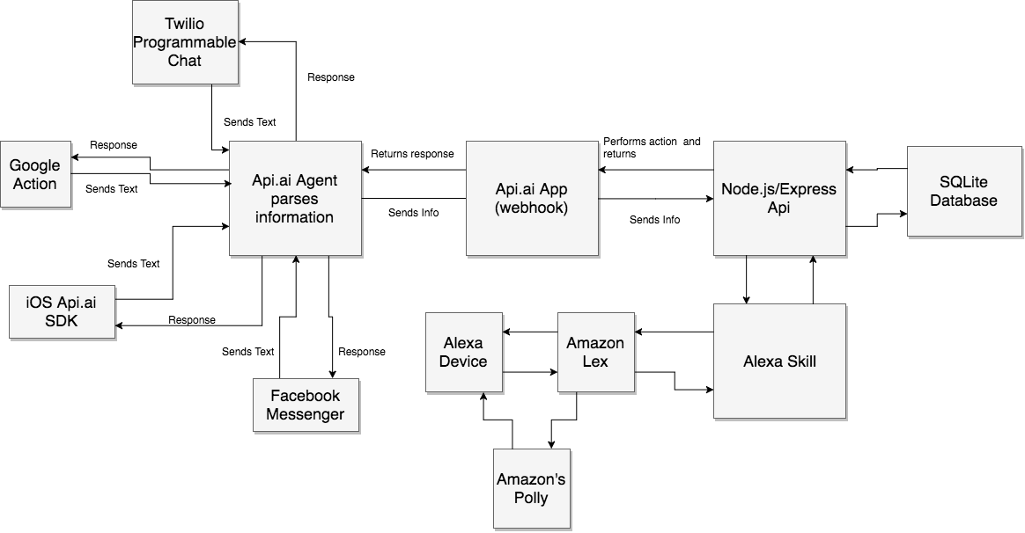
System Architecture
Example of BAD System Architecture Diagram
Delete this slide.
Black and white blurry copy-and-paste from Project Plan document.

Slide 19
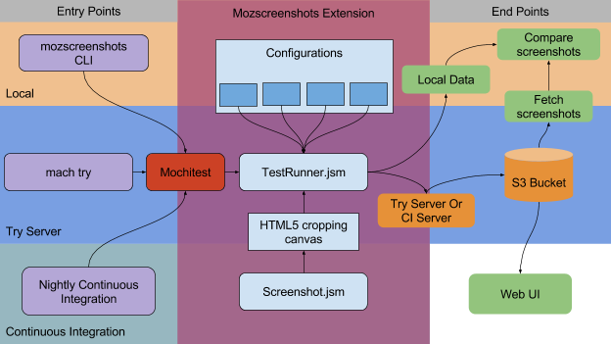
System Architecture
Example of BAD System Architecture Diagram
Delete this slide.
Blurry copy-and-paste from Project Plan document.

Slide 20
System Components
Hardware Platforms
  Point 1
  Point 2
  Point 3
  Etc…
Software Platforms / Technologies
  Point 1
  Point 2
  Point 3
  Etc…
List your hardware and software platforms including all of the technologies that your project will use.
Delete this textbox.

Slide 21
Risks
Risk 1
  Description
  Mitigation
Risk 2
  Description
  Mitigation
Risk 3
  Description
  Mitigation
Risk 4
  Description
  Mitigation
Articulate your major risks.
For each risk, describe what the risk is and how you plan on mitigating it.
DO NOT duplicate this slide. All of your risks must fit on this one slide.
Delete this textbox.

Slide 22
Questions?
?
?
?
?
?
?
?
?
?

